Slide 1


Dynamic Skill-Based Task Allocation for Education
Presented By : Sreelakshmi V B
Under the guidance : Dr. Shidha M V
Scrum Master : Sona Mary Louis

Slide 2
OVERVIEW
Problem
Introduction
Objective
Existing System
Proposed System
Modules
System Requirements
1

Slide 3
PROBLEM
Educational institutions often face difficulties in recruiting educators or volunteers.
Also with specialized skills in teaching methods that cater to students.
2

Slide 4

INTRODUCTION
This project is a web application built using the MERN stack (MongoDB, Express.js, React, and Node.js).
It aims to address the critical issue of finding and connecting skilled educators or staff who specialize in unique and specific teaching methods.
The target audience includes individuals or organizations looking to provide educational services for students and also for differently abled students .
3

Slide 5
OBJECTIVE
Facilitate easy access to educators trained in specific teaching techniques for students with diverse needs.
Improve the quality of education for differently-abled students by ensuring they receive personalized, professional assistance.
Bridge the gap between skilled educators and organizations seeking specialized teaching staff.
4

Slide 6
EXISTING SYSTEM
Schools and organizations typically rely on general job recruitment platforms (e.g., LinkedIn, Indeed) to find educators, including those skilled in special education.
Schools often depend on their local educational networks to share resources and find educators skilled in working with students with disabilities
Educational institutions often advertise their needs for specialized staff through their own websites or through government portals.
5

Slide 7
PROPOSED SYSTEM
The System designed to address the shortcomings of the existing system by providing a platform that connects skilled Trainees with institutions and individuals requiring specialized teaching services.
The platform will also focus on serving differently-abled students by matching them with genuine, trained volunteers.
Each volunteer will have a profile detailing their qualifications, skills, and experience.
After volunteers successfully complete their assignments, they will receive digital certificates acknowledging their contribution.
6

Slide 8
SYSTEM MODULES
Secure Login System: The platform will use secure authentication methods (such as JWT tokens) to ensure that only authorized users can access the system.
Registration : The interested and skilled teaching volunteers can register to the platform and create their profile .
Work Assignment : This module is designed to allow administrators to manage and assign volunteers to specific educational tasks or opportunities based on their skills, availability, and the needs of institutions or differently-abled students.
7

Slide 9
SYSTEM MODULES
4. Genuine Volunteer Validation : Volunteers will be required to undergo a background check before they are approved. This could include identity verification, certifications etc.
5. Availability Tracking : The Volunteer’s status can be updated according to their availability .
6. Suggest Volunteer : Suggest the best volunteers for a teaching request based on their skills, availability, and Rating.
7. Rating : Rating for the Volunteers according to their performance . And the highly rated volunteers are filtered.
8

Slide 10
SYSTEM MODULES
8. Certificate Generation : Generate experience certificate for the volunteers according to their area and duration how long they had worked .
8

Slide 11
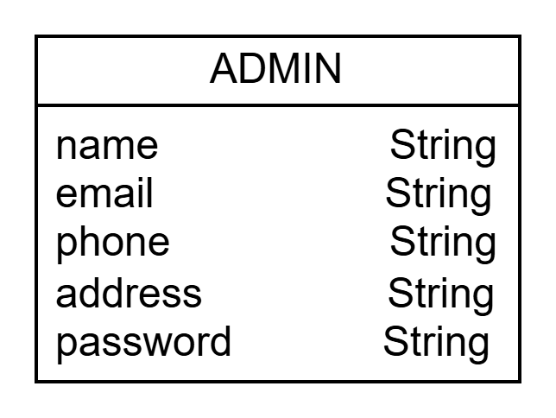
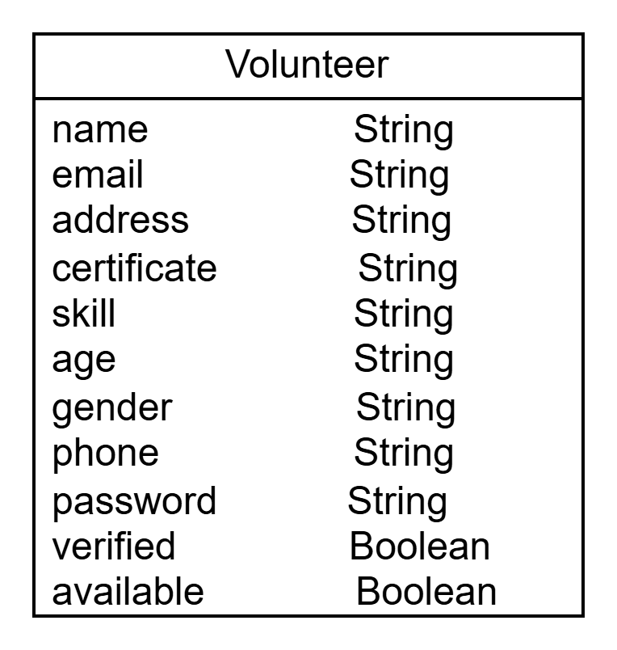
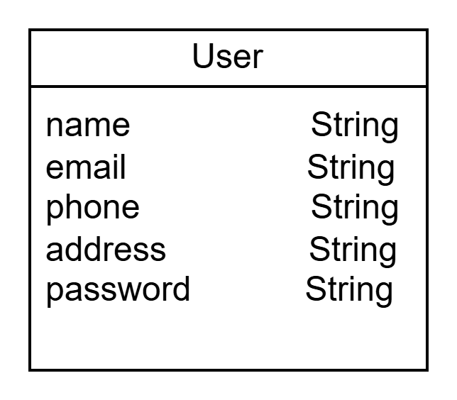
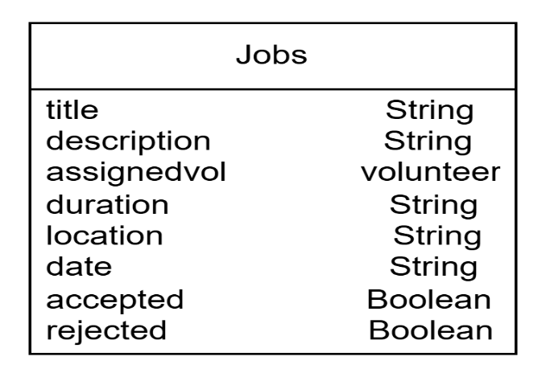
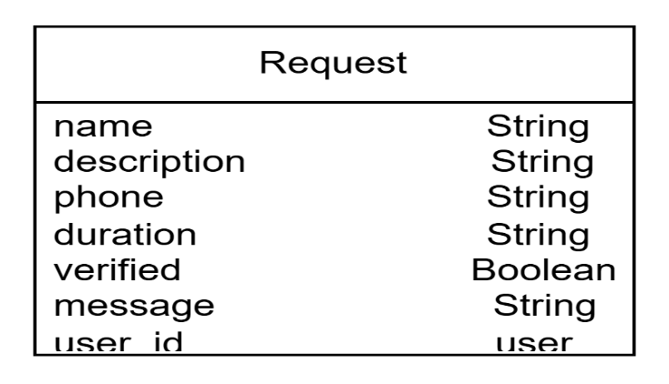
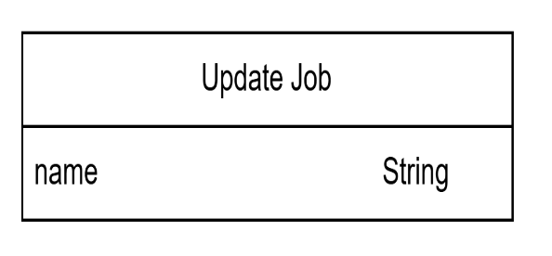
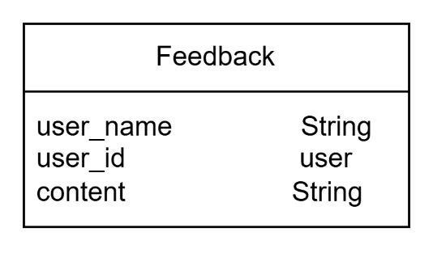
DATABASE SCHEMA
9

Slide 12
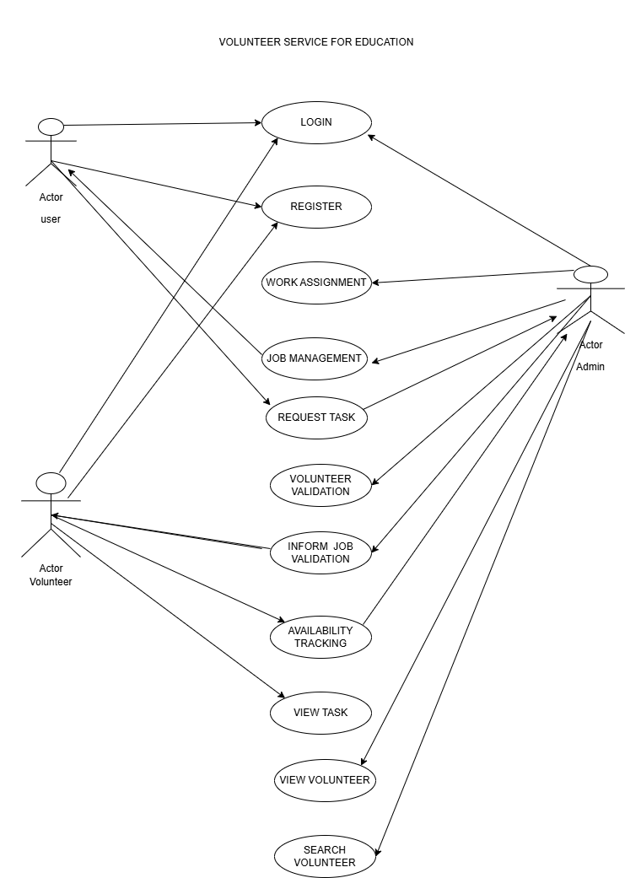
10

Slide 13
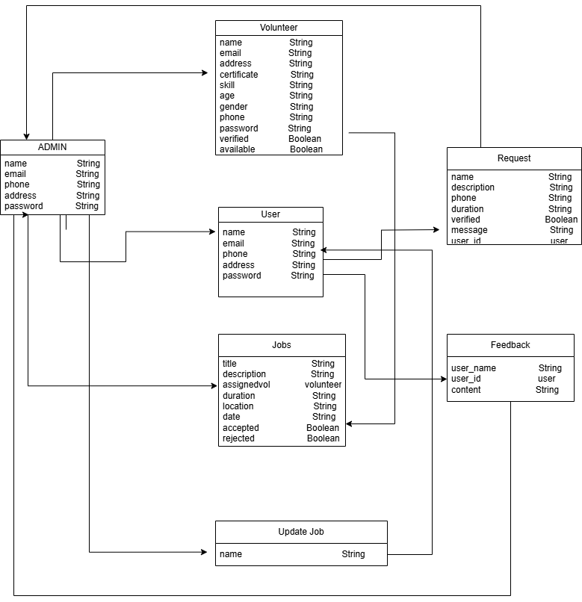
CLASS DIAGRAM
11

Slide 14
SYSTEM REQUIREMENT
Frontend: React, Bootstrap
2. Backend: Node.js, Express, MongoDB, TensorFlow
3. Database: MongoDB
4. Authentication: JWT
5. Deployment: AWS
12

Slide 15
REFERENCES
https://www.volunteerhq.org/volunteer-abroad-projects/teaching/
https://www.signupgenius.com/college/community-service-project-ideas.cfm
16

Slide 16

FISAT | 2025
THANK YOU
Presented By : Sreelakshmi V B

